Slide 1
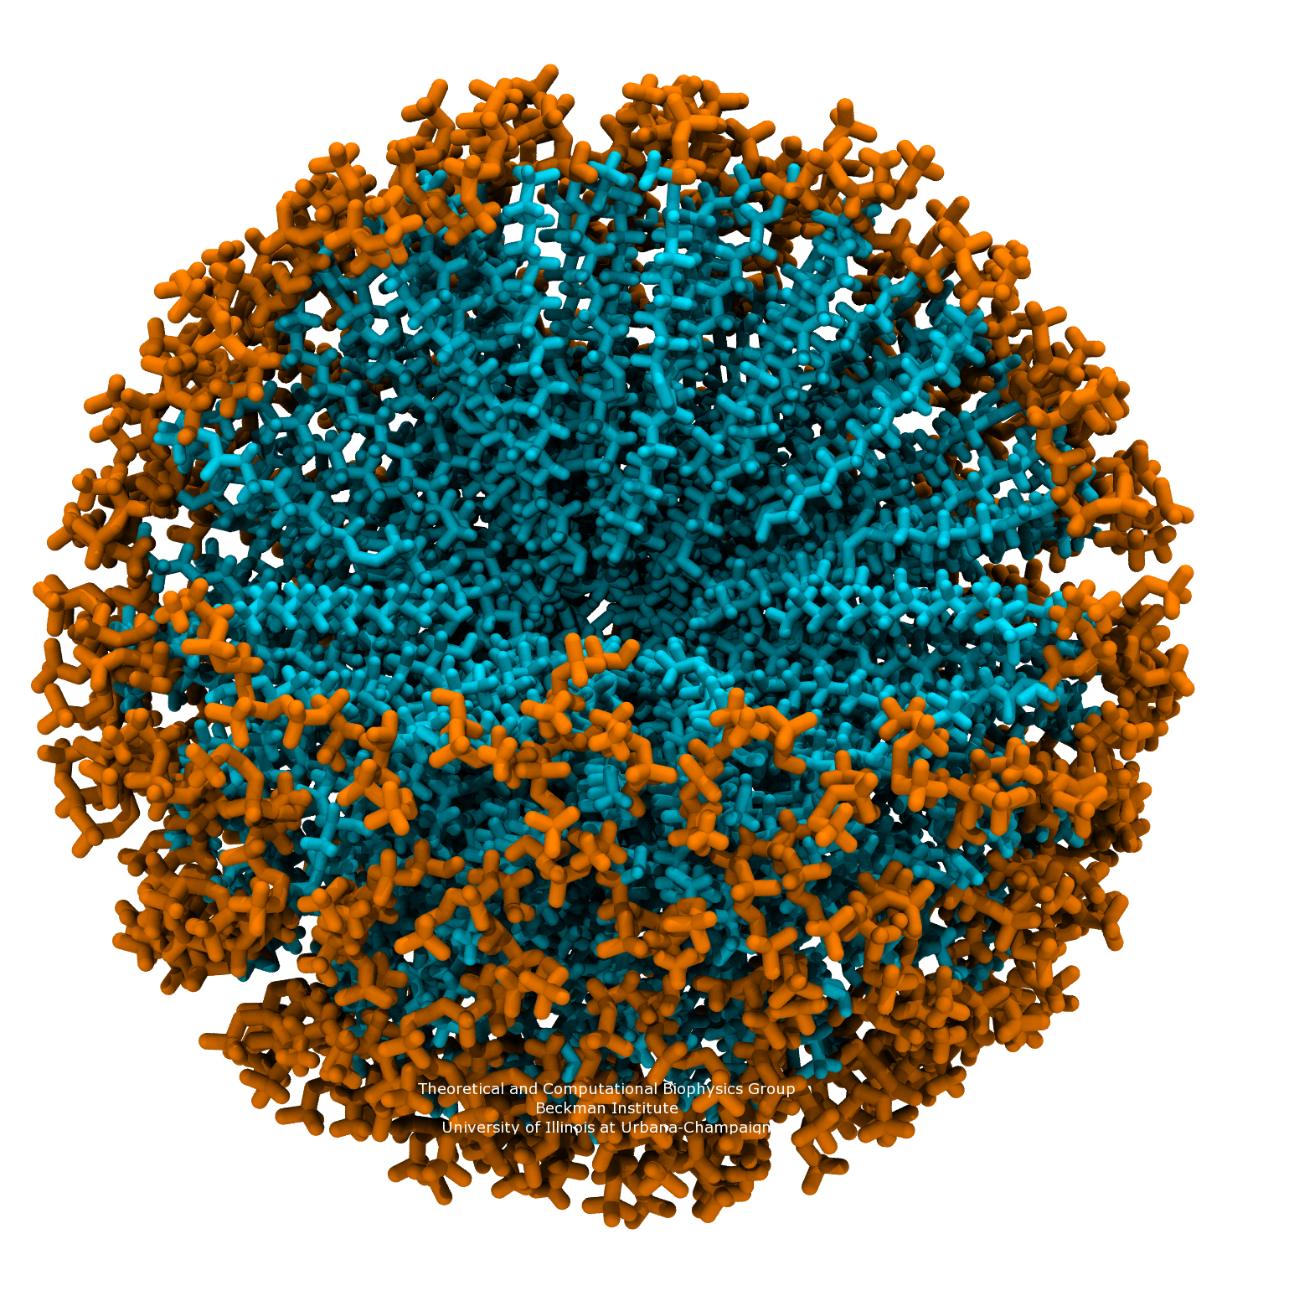
MICELLES
Τράπαλη Αδελαΐς 921
Χημεία Μακροκυκλικών Ενώσεων
Ηράκλειο 2017

Slide 2
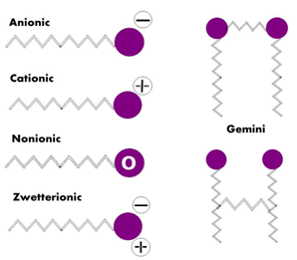
Nonionic surfactants
Surfactants
Amphoteric surfactants
Anionic surfactants
Cationic surfactants
Anionic
Cationic
Gemini
Nonionic
Zwetterionic
Figure 1. Classification of surfactants
PharmaTutor, 2014, 2(3), 17-29
Yoshikiyo Moroi,Department of Chemistry,Faculty of Science,Kyushu University, Fukuoka, Japan

Slide 3
Critical Micelle Concentration:
Temperature
Pressure
Length of hydrophobic tail
Presence & concentration of other surface active substances & electrolytes
Figure 3. Surface tension against the surfactant concentration (logarithmic scale).
http://www.biolinscientific.com/zafepress.php?url=%2Fpdf%2FAttension%2FTheory%20Notes%2FAT_TN_3_cmc.pdf
Figure 4. Changes in micelle shape & structure with changing surfactant concentration.
Micelles,Theoretical and Applied Aspects
Yoshikiyo Moroi,Department of Chemistry,Faculty of Science,Kyushu University, Fukuoka, Japan
Figure 2. Shape & structure of micelles.
N. Pal, A. Bhaumik / Advances in Colloid and Interface Science 189–190 (2013) 21–41

Slide 4
Stabilization of polymer micelles by cross-linking
high core mobility
rigid form
Figure 5. Solution self-assembly of an amphiphilic block copolymer into spherical polymeric micelles and stabilization to afford either shell or core cross-linked polymer micelles.
Phil. Trans. R. Soc. A (2007) 365, 2863–2878

Slide 5
Shell cross - linking
encapsulation agents
reaction vessels
delivery agents
Figure 6. Construction of 0%, 50%, 100 % dinitrophenylated micelles and shell cross-linked nps using a mixed micelle strategy.
Chem. Soc. Rev., 2006, 35, 1068–1083

Slide 6
Surface (and shell) functionalization
Functionalization with:
sugars
peptides
targeting ligands
antibodies
theranostic tools
Figure 7. Possible locations of functionalization within a spherical polymer micelle.
Chem. Soc. Rev., 2006, 35, 1068–1083

Slide 7
nanoscale particle diameter maintenance
(size distribution approx. 1-5 nm)
Figure 8. Synthesis of core azido-functionalized micelles using latent functional monomer.
Chem. Soc. Rev., 2006, 35, 1068–1083

Slide 8
Properties and Applications
Nano-size range (typically < 100 nm) and narrow size
distribution
High static and dynamic structural stability which is essential
for their n vivo application.
Incorporation of large amounts of hydrophobic drug
Shell/core modification
Therapeutic agent (drug,gene,protein) delivery
Drug administration
PhotoDynamic Therapy (PDT)
PhotoThermal Therapy (PTT)
Catalysts
Synthesis of porous materials
Nanomed Nanobiotechnol 2015. doi: 10.1002/wnan.1332

Slide 9
Drug Delivery
di- & tri- copolymers
Biocompatibility, biodegradability and low toxicity
Figure 10. Structure of common micelle forming co-polymer in micellar drug delivery.
WIREs Nanomed Nanobiotechnol 2015. doi: 10.1002/wnan.1332
Figure 9. Selected structural and architectural types of polymer-drug conjugates. A: hydrophilic block, B: hydrophobic block.
Expert Opin. Drug Deliv. (2009) 6(10):1079-1090

Slide 10
longevity in the blood (PEG).
specific targeting (e.g antibodies).
preventing the hidden function from premature interaction with target cells.
Polymeric chains are attached to the carrier surface via low pH-degradable bonds.
pH-dependent de-shielding of the temporarily hidden cell-penetrating function.
Figure 11. (a) Targeting micelle, (b) Redox responsive micelles, (c) interaction of multifunctional micelles with target cells demonstrated.
WIREs Nanomed Nanobiotechnol 2015. doi: 10.1002/wnan.1332

Slide 11
Figure 12. (A) Structure of the dendritic box with an inner fifth generation poly(propylene imine) dendrimers functionalized with t-BOC protected phenylalamine.
Schematic illustration showing the payload entrapment and release by modylation of the surface blocking groups in dendritic box.
Polym. Chem., 2016, 7, 5891-5891 ,DOI: 10.1039/C6PY90145J

Slide 12
Synergistic Imaging/Chemotherapy and Enhanced Tumor Uptake
Theranostic polyprodrugs
reduction-activated camptothecin prodrugs
magnetic resonance (MR) imaging contrast agent (Gd complex)
hydrophilic coronas functionalized with guanidine residues
Figure 13. Schematic illustration of polyprodug unimolecular micelles with hyperbranched cores conjugated with DOTA (Gd) and reductive milieu-cleavable camptothecin prodrugs and hydrophylic coron as functionalized with guanidine residues.
J. Am. Chem. Soc., 2015, 137,362-368.

Slide 13
PhotoDynamic Therapy (PDT) and PhotoThermal Therapy (PTT)
PDT:
photosensitizing agents & light
production of singlet oxygen
PTT: extension of PDT
photoirradiation
excitation of sensitizer
release of vibrational energy (heat)
no need of oxygen to interact with the target cells/tissues
precise tumor localization & enhanced PDT efficacy of PS.

Slide 14
Figure 14. Schematic illustration of PS-loaded micelles integrating cyanine dye for dual-modal cancer imaging and synergistic therapy of PTT and PDT via an enhanced cytoplasmic delivery of PS.
M. Guo et al. / Biomaterials 35 (2014) 4656e4666

Slide 15
Catalysts
Unimolecular micelles: class of single-molecular micelles with distinct core & shell that are covalently bound together.
Polym. Chem., 2016, 7, 5891-5891 ,DOI: 10.1039/C6PY90145J

Slide 16
CuAAC “ click” reactions
high yields
recycled & reused
Figure 15. (a) Nanoreactor/ligand for CuAAC catalysis. (b) Comparison of the NMR signals of the triazole proton of 1 alone
(7.90 ppm), with Cu^{II} and Cu^{I} (shift to 8.08 ppm).
J. Am. Chem. Soc. 2014, 136, 12092−12098

Slide 17
Heck reaction
cross-coupling reactions
short reaction time
high yields
Figure 16. Synthesis route of PdNs-PAMAM-g- MWCNTs hybrid materials
M.R. Nabid et al. / Applied Catalysis A: General 406 (2011) 124– 132

Slide 18
Synthesis of porous materials
Figure 17. Formulation of porous materials. (a) via co-operative self-assembly. (b) via true liquid-crystal templating process.
N. Pal, A. Bhaumik / Advances in Colloid and Interface Science 189–190 (2013) 21–41

Slide 19
Ευχαριστώ πολύ :)

